Slide 1
The Science of Social Networks
or, how I almost know a lot of famous people
Kentaro Toyama
Microsoft Research India
Indian Institute of Science September 19, 2005

Slide 2
Outline
Small Worlds
Random Graphs
Alpha and Beta
Power Laws
Searchable Networks
Six Degrees of Separation

Slide 3
Outline
Small Worlds
Random Graphs
Alpha and Beta
Power Laws
Searchable Networks
Six Degrees of Separation

Slide 4
Trying to make friends
Kentaro
Notes:
When I first decided to move to India, I wondered about how I could make new friends.

Slide 5
Trying to make friends
Microsoft
Bash
Kentaro
Notes:
First, I met Bash at Microsoft, through an NGO called Asha for Eduation.

Slide 6
Trying to make friends
Microsoft
Bash
Asha
Kentaro
Ranjeet
Notes:
Bash suggested I contact Asha’s Bangalore chapter. On my second day in India, I ended up going on a field trip with Asha Bangalore, and met Ranjeet. We started to talk, and when I mentioned I had gone to graduate school at Yale, he said, “I know one person from Yale, but I think he was there earlier than you. His name was Sharad.”

Slide 7
Trying to make friends
Microsoft
Bash
Asha
Kentaro
Ranjeet
Yale
Sharad
New York City
Ranjeet and I already had a friend in common!
Notes:
Sharad was my roommate at Yale.

Slide 8
I didn’t have to worry…
Bash
Kentaro
Sharad
Anandan
Venkie
Karishma
Maithreyi
Soumya

Slide 9
It’s a small world after all!
Bash
Kentaro
Ranjeet
Sharad
Prof. McDermott
Anandan
Prof. Sastry
Prof.
Kannan
Prof. Veni
Prof. Balki
Venkie
Ravi’s
Father
Karishma
Ravi
Prof. Prahalad
Pres. Kalam
Maithreyi
Pawan
Prof. Jhunjhunwala
Soumya
Aishwarya
PM Manmohan
Singh
Dr. Isher Judge
Ahluwalia
Amitabh
Bachchan
Nandana
Sen
Prof. Amartya
Sen
Dr. Montek Singh
Ahluwalia

Slide 10
Society as a Graph
People are represented as nodes.

Slide 11
Society as a Graph
People are represented as nodes.
Relationships are represented as edges.
(Relationships may be acquaintanceship, friendship, co-authorship, etc.)

Slide 12
Society as a Graph
People are represented as nodes.
Relationships are represented as edges.
(Relationships may be acquaintanceship, friendship, co-authorship, etc.)
Allows analysis using tools of mathematical graph theory

Slide 13
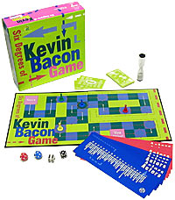
The Kevin Bacon Game
Invented by Albright College students in 1994:
  Craig Fass, Brian Turtle, Mike Ginelly
Goal: Connect any actor to Kevin Bacon, by linking actors who have acted in the same movie.
Oracle of Bacon website uses Internet Movie Database (IMDB.com) to find shortest link between any two actors:
http://oracleofbacon.org/
Boxed version of the
Kevin Bacon Game

Slide 14
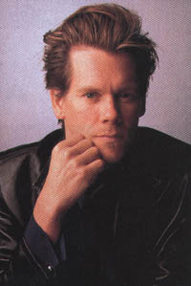

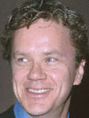






The Kevin Bacon Game
An Example
Kevin Bacon
Mystic River (2003)
Tim Robbins
Code 46 (2003)
Om Puri
Yuva (2004)
Rani Mukherjee
Black (2005)
Amitabh Bachchan
Notes:
(Actually, Amitabh is closer to Kevin, but the minimal path of 4 uses two actors who always play minor parts in movies, so I used this path, which involves better known actors.)

Slide 15

The Kevin Bacon Game
Total # of actors in database: ~550,000
Average path length to Kevin: 2.79
Actor closest to “center”: Rod Steiger (2.53)
Rank of Kevin, in closeness to center: 876th
Most actors are within three links of each other!
Center of Hollywood?
Notes:
Source: Watts (2003), Six Degrees; Barabasi (2003), Linked.

Slide 16






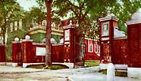

Not Quite the Kevin Bacon Game
Kevin Bacon
Cavedweller (2004)
Aidan Quinn
Looking for Richard (1996)
Kevin Spacey
Bringing Down the House (2004)
Ben Mezrich
Roommates in college (1991)
Kentaro Toyama
Notes:
Ben and I are good friends from college. Ben wrote a book, Bringing Down the House, for which the movie rights were sold to Kevin Spacey (I’ve seen a photo of Ben and Kevin posing in a picture with Hugh Hefner, of all people). Kevin is two movies away from Kevin Bacon.

Slide 17
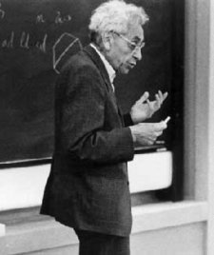
Erdős Number
Number of links required to connect scholars to Erdős, via co-authorship of papers
Erdős wrote 1500+ papers with 507 co-authors.
Jerry Grossman’s (Oakland Univ.) website allows mathematicians to compute their Erdos numbers:
http://www.oakland.edu/enp/
Connecting path lengths, among mathematicians only:
  average is 4.65
  maximum is 13
Paul Erdős (1913-1996)
Notes:
Source: http://www.oakland.edu/enp/trivia.html

Slide 18
Erdős Number
An Example
Paul Erdős
Alon, N., P. Erdos, D. Gunderson and M. Molloy (2002). On a Ramsey-type Problem. J. Graph Th. 40, 120-129.
Mike Molloy
Achlioptas, D. and M. Molloy (1999). Almost All Graphs with 2.522 n Edges are not 3-Colourable. Electronic J. Comb. (6), R29.
Dimitris Achlioptas
Achlioptas, D., F. McSherry and B. Schoelkopf. Sampling Techniques for Kernel Methods. NIPS 2001, pages 335-342.
Bernard Schoelkopf
Romdhani, S., P. Torr, B. Schoelkopf, and A. Blake (2001). Computationally efficient face detection. In Proc. Int’l. Conf. Computer Vision, pp. 695-700.
Andrew Blake
Toyama, K. and A. Blake (2002). Probabilistic tracking with exemplars in a metric space. International Journal of Computer Vision. 48(1):9-19.
Kentaro Toyama

Slide 19
Outline
Small Worlds
Random Graphs
Alpha and Beta
Power Laws
Searchable Networks
Six Degrees of Separation

Slide 20
Random Graphs
N = 12
Erdős and Renyi (1959)
p = 0.0 ; k = 0
N nodes
A pair of nodes has probability p of being connected.
Average degree, k ≈ pN
What interesting things can be said for different values of p or k ?
(that are true as N → ∞)
p = 0.09 ; k = 1
p = 1.0 ; k ≈ ½N²

Slide 21
Random Graphs
Erdős and Renyi (1959)
p = 0.0 ; k = 0
p = 0.09 ; k = 1
p = 0.045 ; k = 0.5
Let’s look at…
Size of the largest connected cluster
p = 1.0 ; k ≈ ½N²
Diameter (maximum path length between nodes) of the largest cluster
Average path length between nodes (if a path exists)

Slide 22
Random Graphs
Erdős and Renyi (1959)
p = 0.0 ; k = 0
p = 0.045 ; k = 0.5
p = 0.09 ; k = 1
p = 1.0 ; k ≈ ½N²
Size of largest component
1
5
11
12
Diameter of largest component
0
4
7
1
Average path length between nodes
0.0
2.0
4.2
1.0

Slide 23
Random Graphs
Erdős and Renyi (1959)
Percentage of nodes in largest component
Diameter of largest component (not to scale)
If k < 1:
  small, isolated clusters
  small diameters
  short path lengths
At k = 1:
  a giant component appears
  diameter peaks
  path lengths are high
For k > 1:
  almost all nodes connected
  diameter shrinks
  path lengths shorten
1.0
0
1.0
k
phase transition
Notes:
This is similar to phase transitions in physics, when gases become liquids and liquids become solids.
(Even Bose-Einstein condensation is also relevant, it seems.)

Slide 24
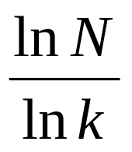
Random Graphs
David
Mumford
Kentaro
Toyama
Erdős and Renyi (1959)
Peter
Belhumeur
Fan
Chung
What does this mean?
If connections between people can be modeled as a random graph, then…
  Because the average person easily knows more than one person (k >> 1),
  We live in a “small world” where within a few links, we are connected to anyone in the world.
  Erdős and Renyi showed that average
  path length between connected nodes is
Notes:
The ln(N) expression is consistent with intuition about branching factors for trees. Even with lots of node repetition, if only 10% of each person’s contacts are not duplicates, links would rapidly span the entire population.
I know Peter from the computer vision community. Peter was a student of Mumford’s, I think. David Mumford is a Fields-Medal-winning mathematician, who has singlehandedly reduced the Erdos number of most computer vision researchers by doing work in computer vision. Fan Chung is a mathematician who has authored papers with both Erdos and Mumford.

Slide 25
Random Graphs
David
Mumford
Kentaro
Toyama
Erdős and Renyi (1959)
Peter
Belhumeur
Fan
Chung
What does this mean?
If connections between people can be modeled as a random graph, then…
  Because the average person easily knows more than one person (k >> 1),
  We live in a “small world” where within a few links, we are connected to anyone in the world.
  Erdős and Renyi computed average
  path length between connected nodes to be:
BIG “IF”!!!

Slide 26
Outline
Small Worlds
Random Graphs
Alpha and Beta
Power Laws
Searchable Networks
Six Degrees of Separation

Slide 27
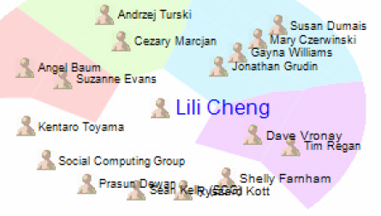
The Alpha Model
Watts (1999)
The people you know aren’t randomly chosen.
People tend to get to know those who are two links away (Rapoport *, 1957).
The real world exhibits a lot of clustering.
The Personal Map
by MSR Redmond’s Social Computing Group
* Same Anatol Rapoport, known for TIT FOR TAT!

Slide 28
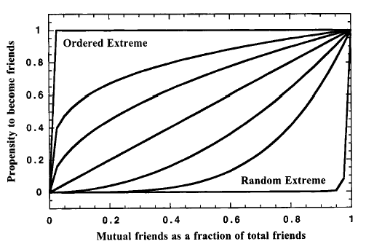
The Alpha Model
Watts (1999)
α model: Add edges to nodes, as in random graphs, but makes links more likely when two nodes have a common friend.
For a range of α values:
  The world is small (average path length is short), and
  Groups tend to form (high clustering coefficient).
Probability of linkage as a function
of number of mutual friends
(α is 0 in upper left,
1 in diagonal,
and ∞ in bottom right curves.)

Slide 29
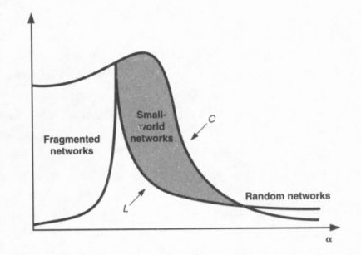
The Alpha Model
Watts (1999)
α model: Add edges to nodes, as in random graphs, but makes links more likely when two nodes have a common friend.
For a range of α values:
  The world is small (average path length is short), and
  Groups tend to form (high clustering coefficient).
Clustering coefficient /
Normalized path length
Clustering coefficient (C) and
average path length (L)
plotted against α
α
Notes:
Source: Duncan Watts, Six Degrees (2003).

Slide 30
The Beta Model
Watts and Strogatz (1998)
β = 0
β = 0.125
β = 1
People know
their neighbors.
Clustered, but
not a “small world”
People know
their neighbors,
and a few distant people.
Clustered and
“small world”
People know
others at
random.
Not clustered,
but “small world”

Slide 31
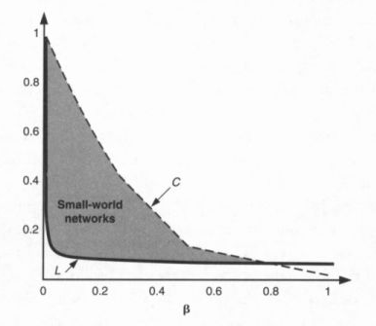
The Beta Model
Jonathan
Donner
Kentaro
Toyama
Watts and Strogatz (1998)
Nobuyuki
Hanaki
First five random links reduce the average path length of the network by half, regardless of N!
Both α and β models reproduce short-path results of random graphs, but also allow for clustering.
Small-world phenomena occur at threshold between order and chaos.
Clustering coefficient /
Normalized path length
Clustering coefficient (C) and average
path length (L) plotted against β
Notes:
Source: Duncan Watts, Six Degrees (2003).
Small-world phenomena of random graphs emerges even with less random links.
Jonathan Donner will be working with us at MSR India. Jonathan is now at the Earth Institute at Columbia, where he knows Nobuyuki Hanaki, who has co-authored papers with Duncan Watts.

Slide 32
Outline
Small Worlds
Random Graphs
Alpha and Beta
Power Laws
Searchable Networks
Six Degrees of Separation

Slide 33
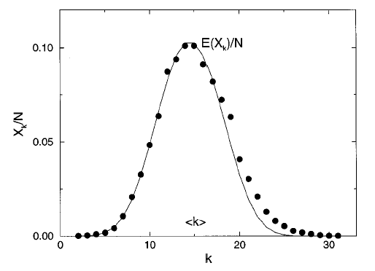
Power Laws
Albert and Barabasi (1999)
What’s the degree (number of edges) distribution over a graph, for real-world graphs?
Random-graph model results in Poisson distribution.
But, many real-world networks exhibit a power-law distribution.
Degree distribution of a random graph,
N = 10,000 p = 0.0015 k = 15.
(Curve is a Poisson curve, for comparison.)
Notes:
Source: Albert and Barabasi, “Statistical mechanics of complex networks.” Review of Modern Physics. 74:48-94. (2002)

Slide 34
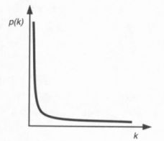
Power Laws
Albert and Barabasi (1999)
What’s the degree (number of edges) distribution over a graph, for real-world graphs?
Random-graph model results in Poisson distribution.
But, many real-world networks exhibit a power-law distribution.
Typical shape of a power-law distribution.
Notes:
Source: Duncan Watts, Six Degrees (2003).

Slide 35
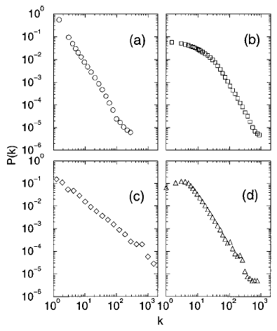
Power Laws
Albert and Barabasi (1999)
Power-law distributions are straight lines in log-log space.
How should random graphs be generated to create a power-law distribution of node degrees?
Hint:
Pareto’s* Law: Wealth distribution follows a power law.
Power laws in real networks:
(a) WWW hyperlinks
(b) co-starring in movies
(c) co-authorship of physicists
(d) co-authorship of neuroscientists
* Same Velfredo Pareto, who defined Pareto optimality in game theory.
Notes:
Source: Albert and Barabasi, “Statistical mechanics of complex networks.” Review of Modern Physics. 74:48-94. (2002)

Slide 36
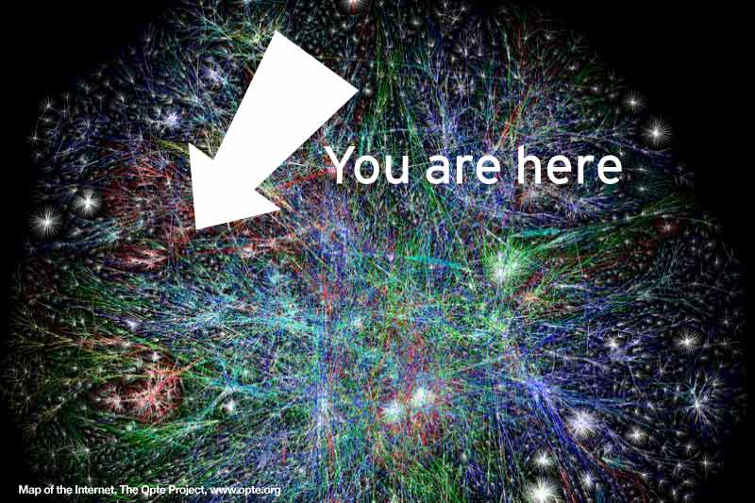
Power Laws
Anandan
Kentaro
Toyama
Albert and Barabasi (1999)
Jennifer
Chayes
“The rich get richer!”
Power-law distribution of node distribution arises if
  Number of nodes grow;
  Edges are added in proportion to the number of edges a node already has.
Additional variable fitness coefficient allows for some nodes to grow faster than others.
“Map of the Internet” poster

Slide 37
Outline
Small Worlds
Random Graphs
Alpha and Beta
Power Laws
Searchable Networks
Six Degrees of Separation

Slide 38

Searchable Networks
Kleinberg (2000)
Just because a short path exists, doesn’t mean you can easily find it.
You don’t know all of the people whom your friends know.
Under what conditions is a network searchable?

Slide 39
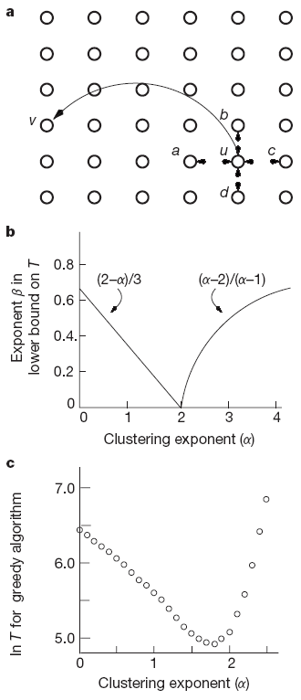
Searchable Networks
Kleinberg (2000)
Variation of Watts’s β model:
  Lattice is d-dimensional (d=2).
  One random link per node.
  Parameter α controls probability of random link – greater for closer nodes.
b) For d=2, dip in time-to-search at α=2
  For low α, random graph; no “geographic” correlation in links
  For high α, not a small world; no short paths to be found.
Searchability dips at α=2, in simulation
Notes:
Source: Jon Kleinberg, “Navigation in a small world.” Science, 406:845 (2000).

Slide 40
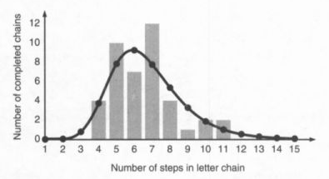
Searchable Networks
Kentaro
Toyama
Kleinberg (2000)
Ramin
Zabih
Watts, Dodds, Newman (2002) show that for d = 2 or 3, real networks are quite searchable.
Killworth and Bernard (1978) found that people tended to search their networks by d = 2: geography and profession.
The Watts-Dodds-Newman model
closely fitting a real-world experiment
Notes:
Source: Duncan Watts, Six Degrees (2003).
I know Ramin as a computer vision researcher. Ramin is in the CS department at Cornell; I assume he knows Jon Kleinberg.

Slide 41
Outline
Small Worlds
Random Graphs
Alpha and Beta
Power Laws
Searchable Networks
Six Degrees of Separation

Slide 42

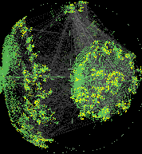
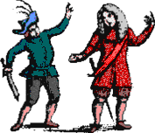
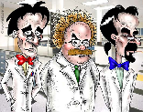
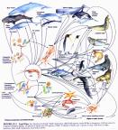
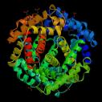
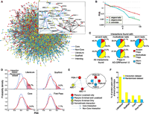
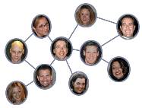
Applications of Network Theory
World Wide Web and hyperlink structure
The Internet and router connectivity
Collaborations among…
  Movie actors
  Scientists and mathematicians
Sexual interaction
Cellular networks in biology
Food webs in ecology
Phone call patterns
Word co-occurrence in text
Neural network connectivity of flatworms
Conformational states in protein folding
Notes:
Source: Albert and Barabasi, “Statistical mechanics of complex networks.” Review of Modern Physics. 74:48-94. (2002)

Slide 43
Credits
Albert, Reka and A.-L. Barabasi. “Statistical mechanics of complex networks.” Reviews of Modern Physics, 74(1):47-94. (2002)
Barabasi, Albert-Laszlo. Linked. Plume Publishing. (2003)
Kleinberg, Jon M. “Navigation in a small world.” Science, 406:845. (2000)
Watts, Duncan. Six Degrees: The Science of a Connected Age. W. W. Norton & Co. (2003)

Slide 44
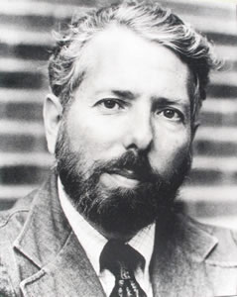
Six Degrees of Separation
Milgram (1967)
The experiment:
Random people from Nebraska were to send a letter (via intermediaries) to a stock broker in Boston.
Could only send to someone with whom they were on a first-name basis.
Among the letters that found the target, the average number of links was six.
Stanley Milgram (1933-1984)
Notes:
Milgram was a brilliant psychologist, notorious for his studies of obedience, where subjects continued to deliver what they believed to be painful electric shocks, just because a person in a lab coat told them they should do so as part of an experiment.
Note on the small-worlds experiment:
– Not many of the letters in the original experiment arrived.
-- The experiment presaged some later discoveries, including hubs, tendency to go by geography and profession, etc.

Slide 45

Six Degrees of Separation
Kentaro
Toyama
Milgram (1967)
Robert
Sternberg
Allan
Wagner ?
Mike
Tarr
John Guare wrote a play called Six Degrees of Separation, based on this concept.
“Everybody on this planet is separated by only six other people. Six degrees of separation. Between us and everybody else on this planet. The president of the United States. A gondolier in Venice… It’s not just the big names. It’s anyone. A native in a rain forest. A Tierra del Fuegan. An Eskimo. I am bound to everyone on this planet by a trail of six people…”
Notes:
This link to Milgram is my best guess, based on information I could find on the Internet: Allan Wagner was at the Yale Psychology department through 1961-1962, when Milgram did his experiments. Sternberg was chairman of the psych dept in 1992, during which time, both Allan Wagner and Mike Tarr were in the same department. I know Mike.

Slide 46
Thank you!

